Slide 1
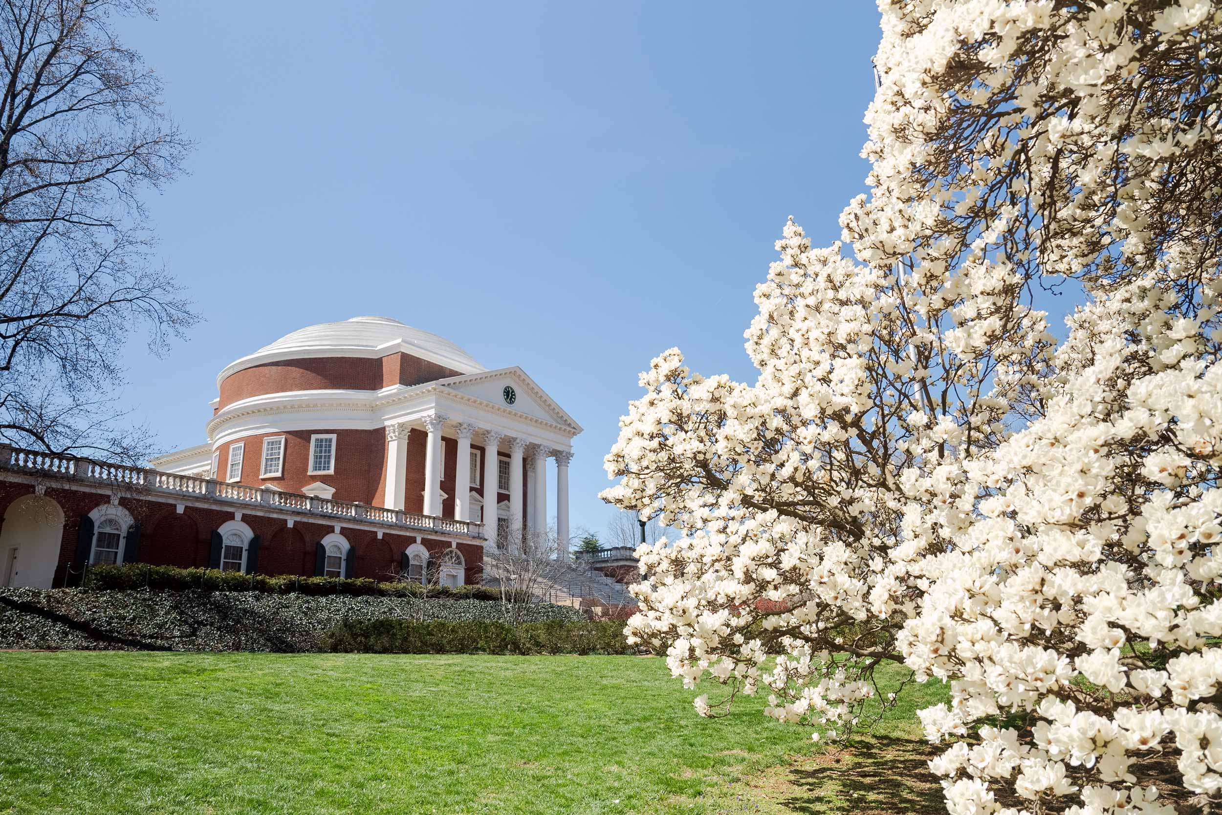
VPR Training and Communications Team

Slide 2
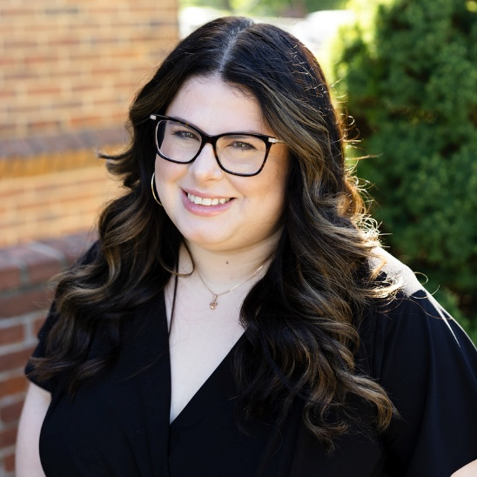
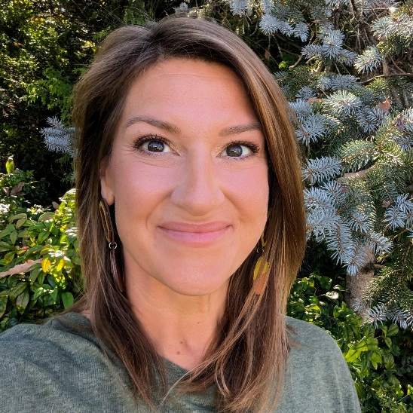
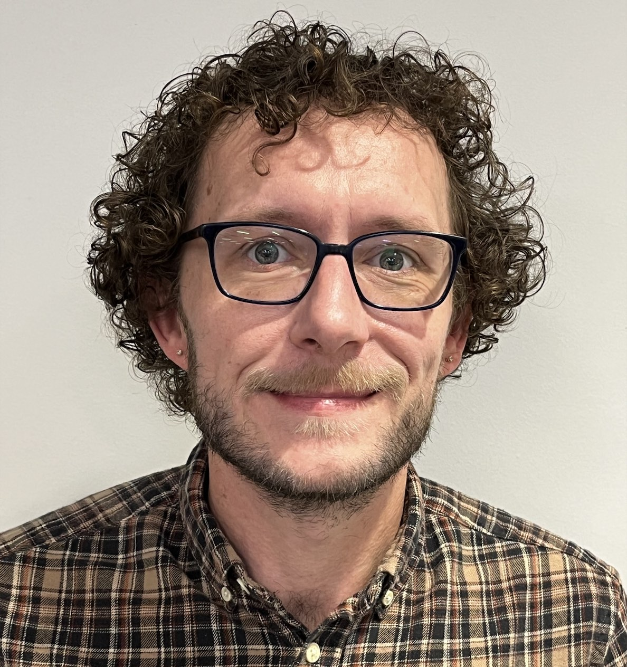
Training, Communication, and Outreach
Erika Priddy
Marina Muchnik
Jaime Petrasek
Stephan Cooley
Training Development Manager
Training Development Specialist
Senior Training Development Specialist
Research Navigator

Slide 3
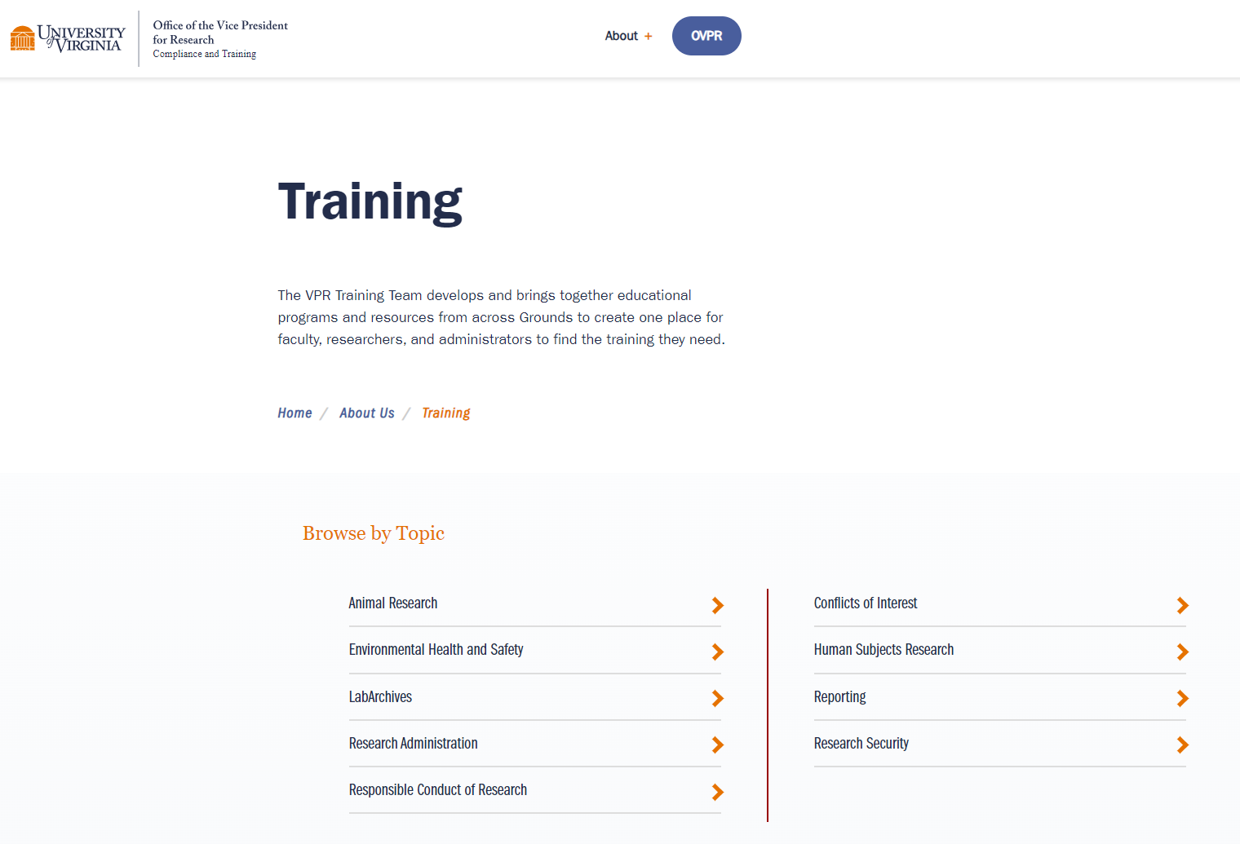
Training Website
Don’t forget to bookmark our training website!
Check it out!
https://compliance.research.virginia.edu/about/training

Slide 4
Intro to Huron Update 10.5

Slide 5
Huron Update 10.5 Expectations
End Users can expect the following:
Changes that may be noticeable, but don't affect the end user in the field, such as: 424 form updates, back-end Info Team changes, and action enhancements and updates that are specific to OSP Central staff
Noticeable USER INTERFACE CHANGES that require advance planning, additional guidance, and training...we are working on that now
"Big Ticket Item" changes that are larger in scope...more on that later!

Slide 6
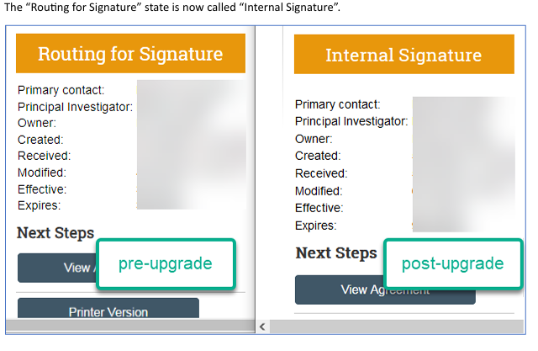
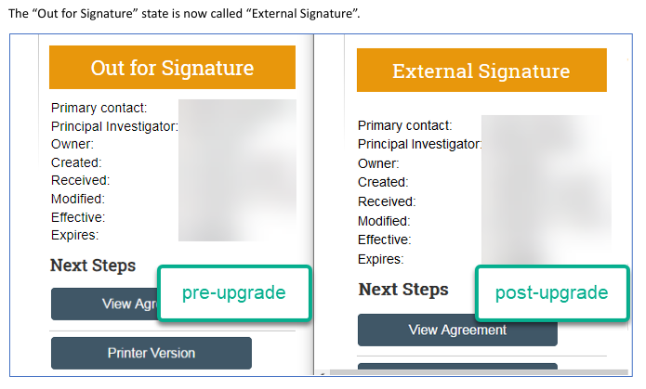
Change Example (Agreements)
Notes:
Example of an OSP Central action enhancement and change that may not necessarily affect the end user in the field but that they may notice and wonder why things look differently:
The states that are displayed in the Agreements module have been revised to make it more clear where the agreement is in the signature process

Slide 7
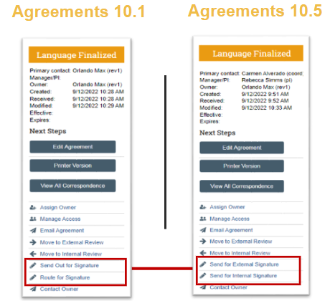
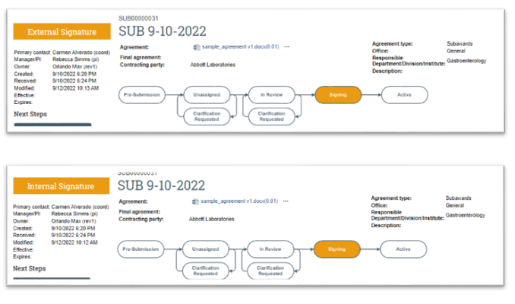
Change Example (Agreements)
Notes:
These changes are reflected in the action "buttons" for OSP central staff charged with reviewing, negotiating, and sending out agreements for signatures

Slide 8
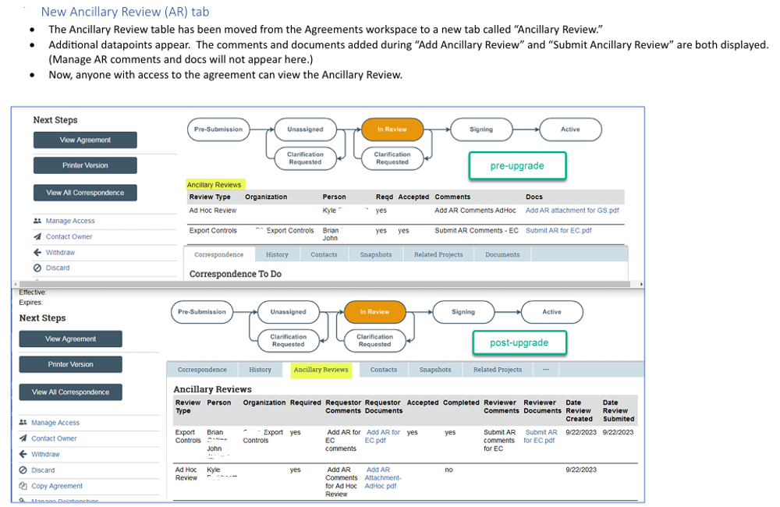
User Interface Change Example (Agreements)
Notes:
Example of a Noticeable USER INTERFACE CHANGE that requires advance planning, additional guidance, and training: The ancillary reviews on the Agreements module will now move to their own separate "tab" and more details will be viewable

Slide 9
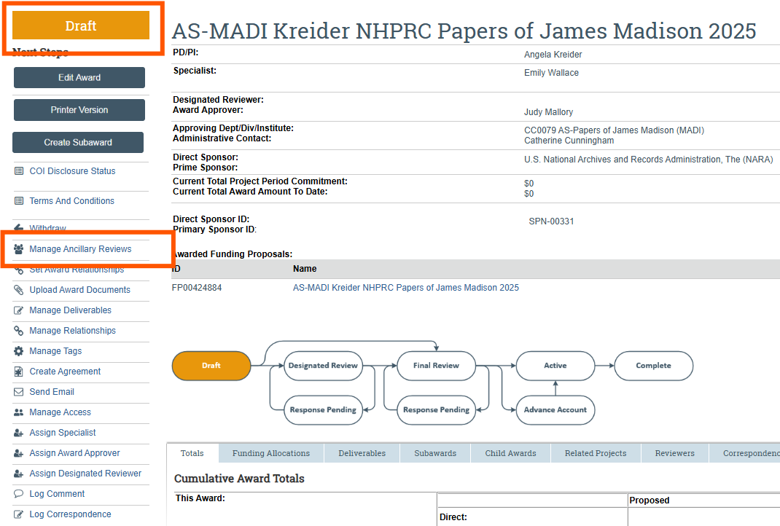
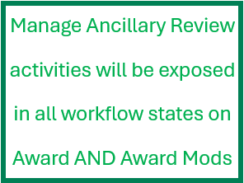
User Interface Change Example (Grants)
Notes:
And speaking of ancillary reviews.....the Manage Ancillary Review activities will be exposed in all workflow states on Awards and Award Mods in the Grants module.

Slide 10
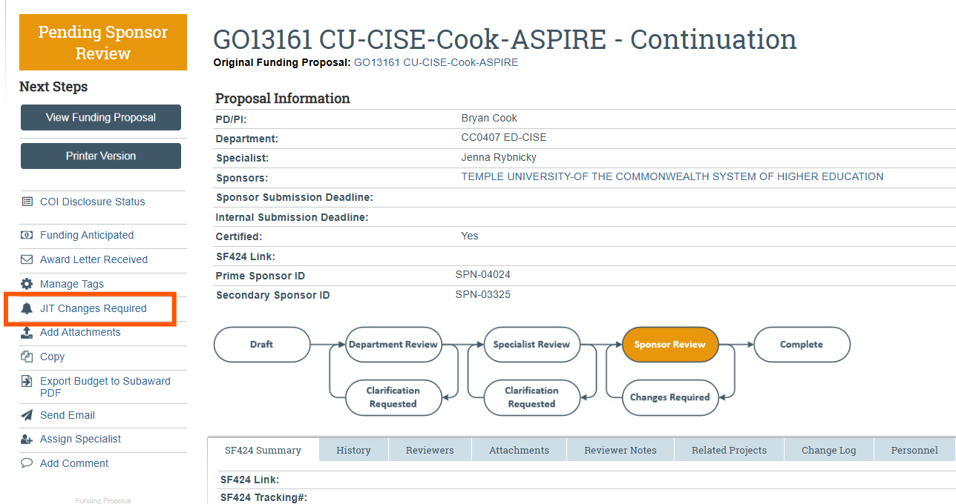
User Interface Change Example (Grants)
Notes:
The JIT Changes Required activity will be changed to display the "Post Submission Updates" Activity – so users will see it displayed differently

Slide 11
Examples
Notes:
The steering committee is reviewing information from Huron and gathering data that helps to inform decisions and to ensure larger changes are as Vonda would say, ready for prime time.
Big ticket items the steering committee is focused on are:
the FP budget can allow an enhancement to budget for person months instead of or in addition to our current practice of % effort budgeting
An additional certify button can be made available for faculty beyond the PI on the project
The tagging feature that is available on Funding Proposals can now be made available on the agreements side of Huron

Slide 12
Timeline, including Training & Communications
Huron 10.5 will “Go-Live” this summer (date TBD), but you can expect the following:
Super User sessions – early April
Draft of Change Guide for end users – mid-April
User Acceptance Testing – April 21 – May 30
Training Sessions – beginning in June
Office Hours – after Go-Live
Communications – throughout! (Blog updates, newsletters, Spotlight meetings)
Subscribe to the monthly newsletter
Check out the OSP Blog

Slide 13
Community Ask
Call for Volunteers!
"Super User" Sessions
and...
User Acceptance Testing
Email MaryBeth:
mas7zt@virginia.edu
Notes:
Message from Marybeth: Looking for volunteers to join OSP in BOTH Super User group discussions AND testing – lunch, early mornings, other times that fit schedules
CORE TEAM – you are already considered Sper Users, so your email is on the way ☺ Other interested folks, please Email MB to participate as a Super User

Slide 14
Questions

